Slide 1
Hack-AI-thon
– AI-Healthops
– Defend3r
Trellix

Slide 2
Summary & Team
Title: AI-Healthops
Summary:
AI-Healthops is AI based agent health monitoring and reporting the system resource usage of Trellix endpoint product.
Team Members:
Nilesh Kumar - Developer, nilesh.kumar@trellix.com
Xin tang - Developer, xin.tang@trellix.com
GitHub Repo: https://github.com/nilesh-trellix/AI-Healthops

Slide 3
Problem Statement & Objective
Title: AI based agent health report
Problem: "Our endpoint customer/IT administrators struggle to pinpoint whether the security agent(or any other process) is the true cause of slow computer, leading to lengthy troubleshooting and user frustration."
Objective: “AI-Healthops eliminates the guesswork in performance troubleshooting by delivering an AI-powered health report that precisely identifies which processes are slowing down a computer.”

Slide 4
Solution Overview
Title: AI-Healthops is AI based agent health report. Monitoring and reporting the system resource usage of Trellix endpoint product.
Summary: Pinpoints the Root Cause: Instead of administrators hunting for the problem, AI-Healthops continuously monitors system resources and uses its AI engine to automatically flag the exact process. Replaces Guesswork with Data: It transforms the support conversation from "I think the agent is slow" to "The data shows the agent's CPU usage spiked at 2:15 PM.Reduces Resolution Time: By providing clear, actionable data, it cuts down troubleshooting time from hours or days to minutes.
Key Highlights:
Real-time updates : Yes
Cross-platform integration : Yes
User-friendly UI : Yes

Slide 5
Key Features & Demo
Title: What It Can Do (So Far)
Feature 1: Predictive Health Scoring
Feature 2: Root Cause Correlation Engine
Feature 3: One-Click Remediation Actions
Feature 4: The Endpoint Health Dashboard
Demo Link: [Insert YouTube/GitHub Pages/Loom link] (Or add screenshots if live demo isn't available)

Slide 6
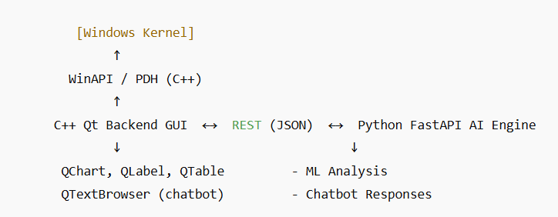
Tech Stack & Architecture
Title: How We Built It
Tech Stack:
Frontend: C++ QT framework
Backend: WINAPI, Python(Vertex API)
Database: SQL
Hosting: onPrem
Architecture Diagram:

Slide 7
Impact & Future Scope
Title: Why It Matters & What’s Next
Impact: Reduces Resolution Time- By providing clear, actionable data, it cuts down troubleshooting time from hours or days to minutes, freeing up IT resources and significantly reducing end-user frustration.
Future Enhancements:
AI-based graphical view.
Notification
Chatbot

Slide 8
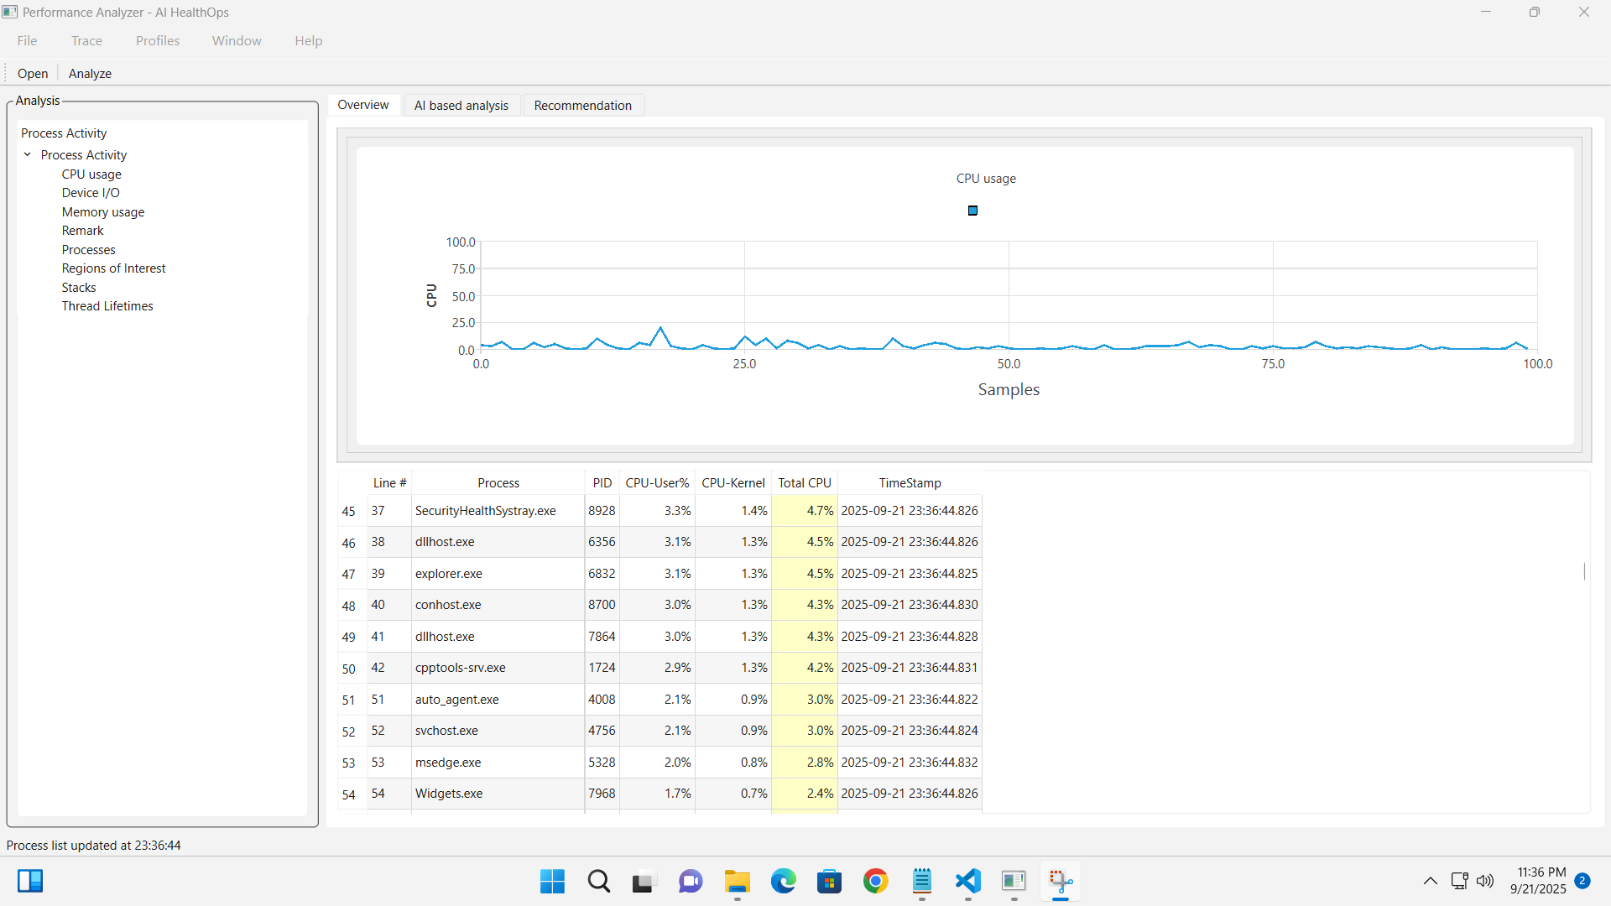
Application: Page#1
Overview: Graph and table

Slide 9
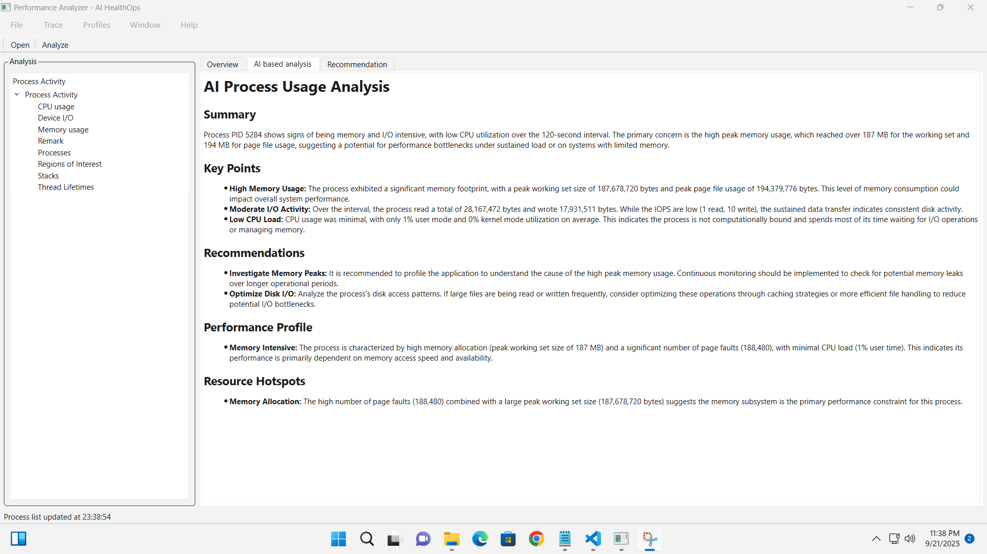
Application: Page#2
AI Process Usage Analysis

Slide 10
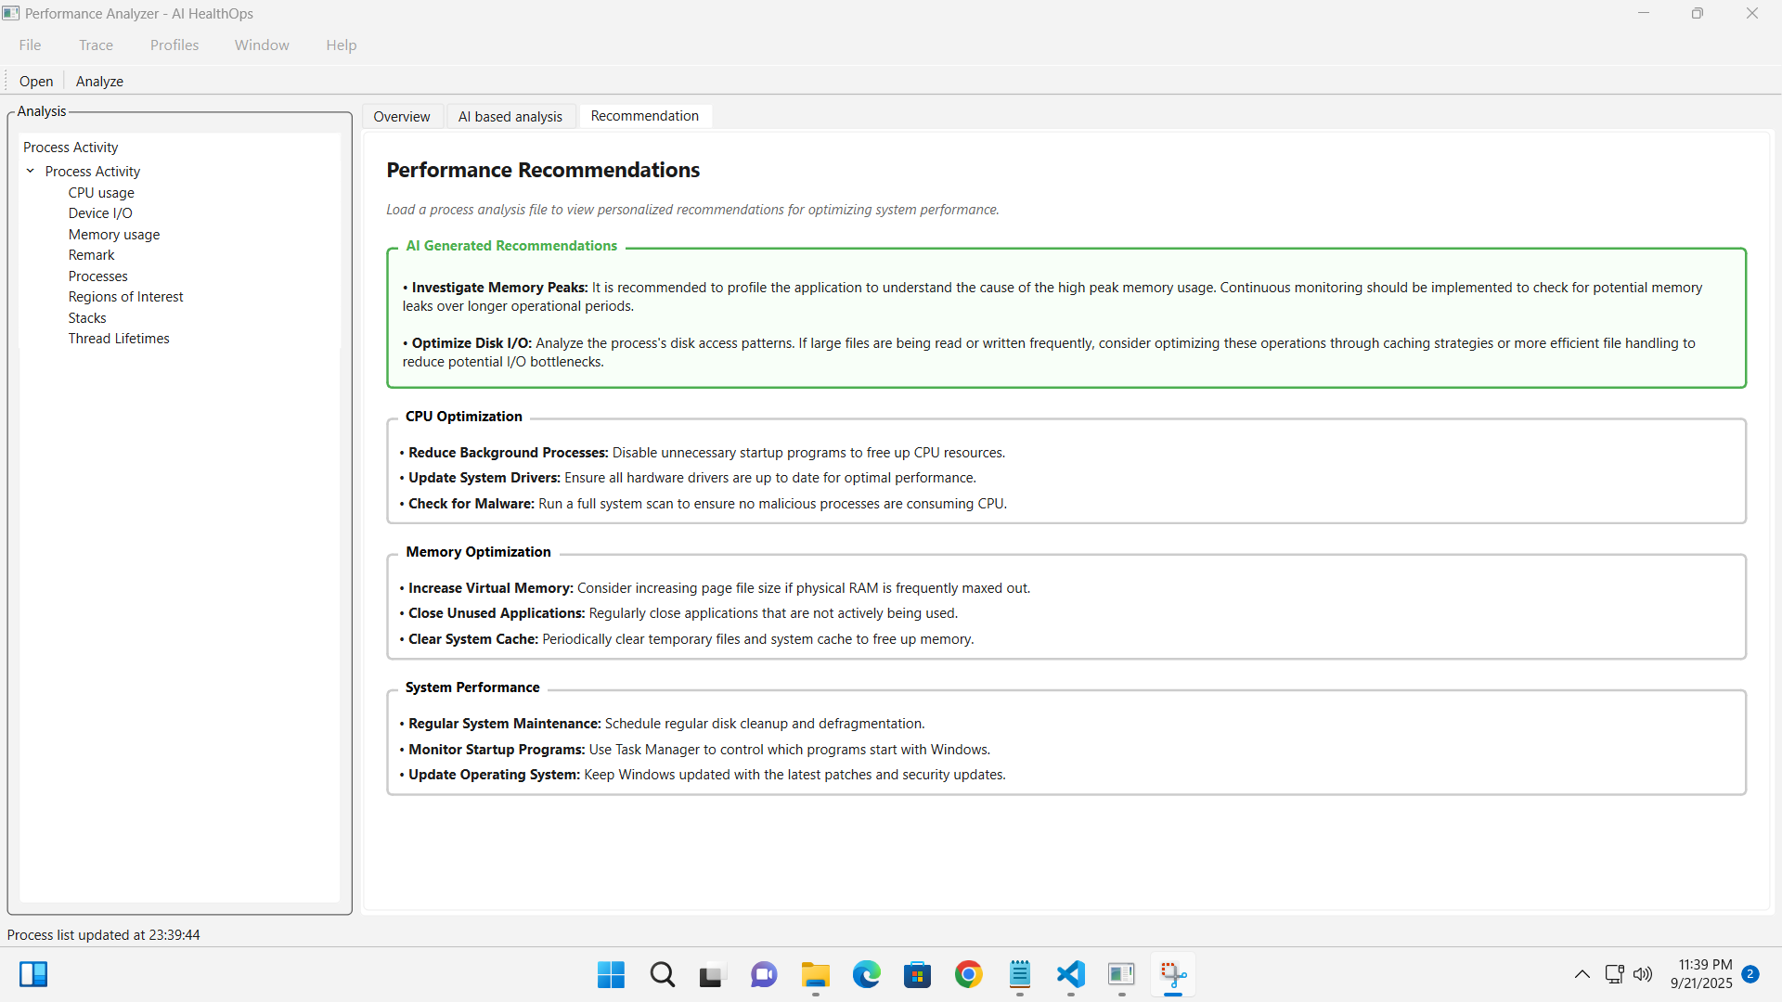
Application: Page#3
Performance Recommendations

